Slide 1


QUESTIONNAIRE
Your Revision Partner
TEAM- Karma Bytes Back
TEAM MEMBERS
~ Akanksha
~Apoorva Sinha
EDUTHON-EDUCATION THEMED HACKATHON
01

Slide 2

PROBLEM STATEMENT
The most important part about learning is, REVISION! Understanding the concepts is what everyone should focus on but one cannot ignore the importance of revision and consolidating the knowledge gained,hence revision.This is especially true while studying subjects like History, Geography etc.,where forgetting the facts is easy.
The best way to test your knowledge is by attempting questions, which also helps in revising and reviewing what you have learnt.
But Revising is such a mundane task, don't you agree? You just don't know where to begin from!
And all you have is a textbook...

Slide 3
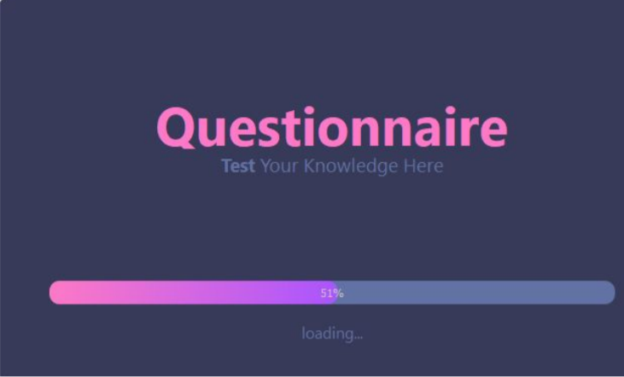
PROPOSED SOLUTION
Questionnaire to the rescue!
Questionnaire, is the most efficient way to revise. All you need to do is upload an image, of the text that you need to revise. And let the questionnaire generate questions for you!
We provide with two kinds of questions :
1)Short Answer
2)Fill in the blanks.
We have chosen these type of questions,because they ensure complete revision along with the fact that they aren't time consuming.Both of the type of questions provide with holistic revision.

Slide 4

3.
UNIQUE SELLING POINTS
PDFs generated : Don't have access to the internet all the time? No problem. We also provide PDF of the questions generated so that the student can have a look at it later as well.
1.
PEasy-to-use : You don't have to copy+paste any text, or highlight the important keywords, all you have to do is, upload an image in order to generate your questions! Can things get easier than this? With the advent of e-books it only makes sense to use applications like Questionnaire for revision.
4.
Quiz which makes revising easy and fun : Students can give a quiz based on "Fill in the blank" questions they have generated and know their score,thus testing their knowledge of the text
2.
5.
Two type of questions available : We provide 2 types of questions - Fill in the Blanks and Short Answer type Questions for holistic revision.
● List of short answer type questions : We provide the students with the list of short answer type questions and we do not provide solutions/answers because we believe that, it would limit the thinking capability of the student and every student has their own writing style.

Slide 5

YOUR TECH STACK
1.
Python(because why not? :D) : For the complete program
2.
PyQT5 : For the GUI
3.
Quillionz API : For generating questions
…. And various other modules

Slide 6
THANK YOU
Feel free to add more slides!

